Slide 1
Customer Segmentation Analysis
Group 3: April Yang, Cheryl Liu, Yifei Wang

Slide 2
Business Context
Businesses may struggle to effectively target and market to each customer group with personalized messaging and offers.
Customer segmentation can divide customers into segments to optimize the significance of each customer group to the business.
Modify products and implement different marketing campaigns according to distinct needs and behaviors of the customers to increase potential sales and revenue.
Help business to cater to the concerns of different types of customers.

Slide 3
Agenda
Data Analysis
Model Approach
Cluster Analysis
Marketing Strategy

Slide 4
Data Analysis
EDA
Feature Engineering
Dimensionality Reduction

Slide 5
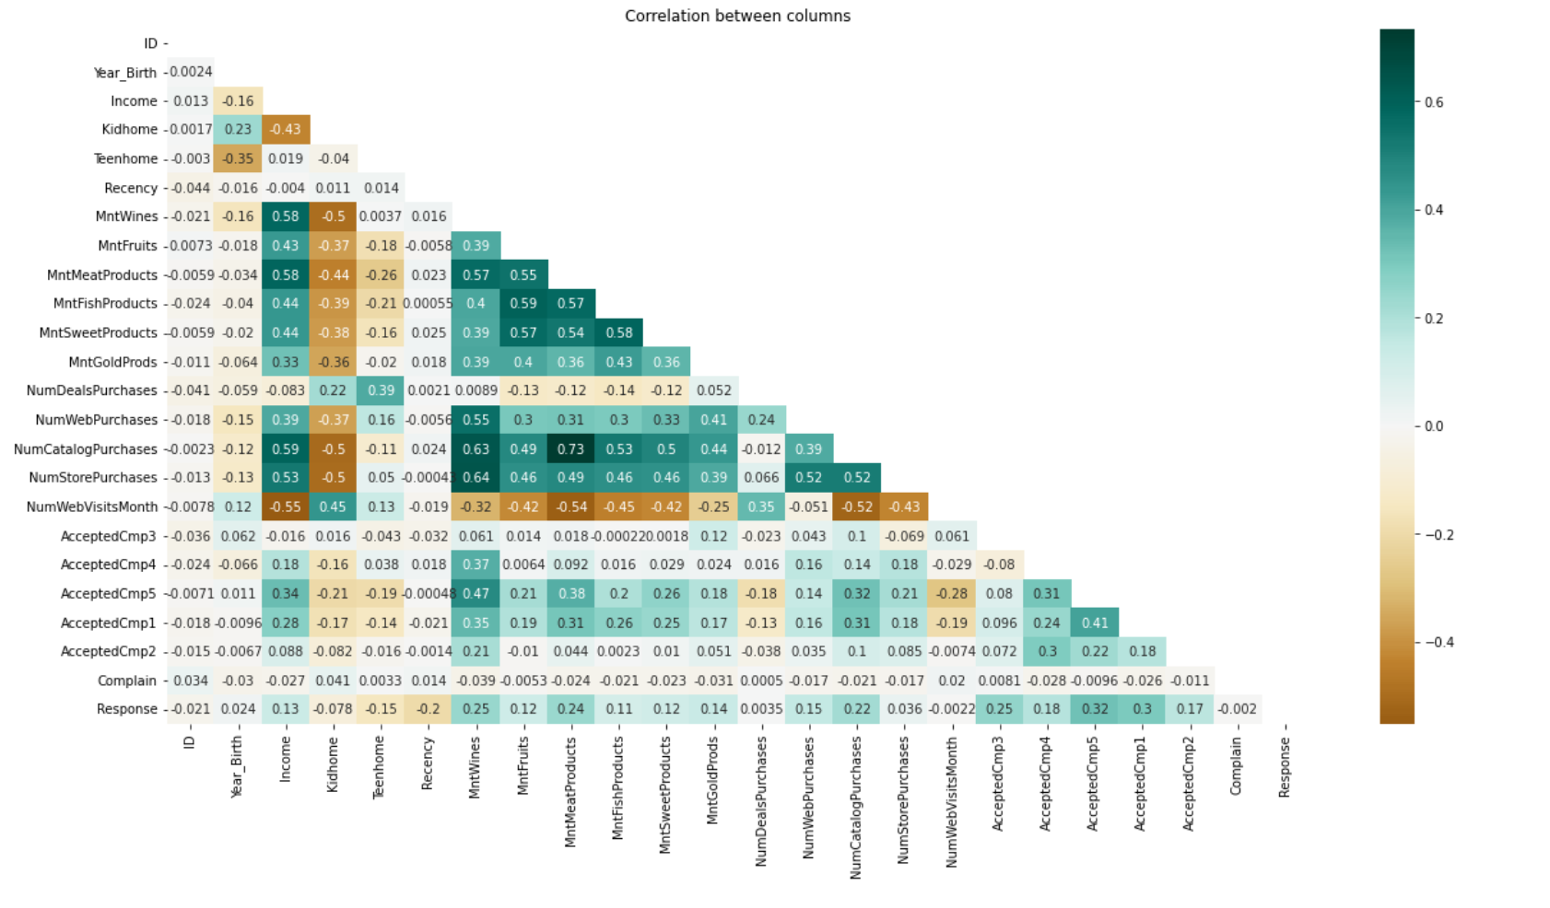
EDA- Correlation Heatmap

Slide 6
Amount spent on wine in last two years is positively correlated (correlation > 0.5) with :
the number of purchases made using a catalogue
the number of purchases made directly in stores
amount spend on meat in last two years
Amount spend on meat in last two years is positively correlated (correlation > 0.5) with:
the number of purchases made using a catalogue
amount spend on fish in last two years
amount spend on sweats in last two years
Amount spend on meat in last two years is negatively correlated (correlation < -0.5) with:
number of visits to company's website in the last month
Income is positively correlated (correlation >0.5) with:
Amount spent on wine in last 2 years
Amount spent on meat in last 2 years
Number of purchases made through the company’s website
Income is negatively correlated (correlation < - 0.5) with:
Number of visits to company’s website in the last month

Slide 7
Feature engineering
Age: data["Age"] = 2021-data["Year_Birth"]
Total spending: spend on Wines+ Fruits+ Meat Products+ Fish Products + Sweet Products + Gold Prods
Children number: #kids + #teenagers
Is Parent: 0 if not parent, 1 if is parent
Segmenting education levels in 3 groups:
Undergraduate: Basic, 2n Cycle
Graduation: Graduated undergrads
Postgraduate: Master, PhD
Live with: 0 if live alone, 1 if not
Customer life time: # of days being a customer of the grocery store

Slide 8
Remove outliers
Only investigate customer with age < 90
Only investigate customer with annual income < 600,000

Slide 9
Columns After feature engineering
'Education’,
'Income’,
'Recency’,
'Wines’,
'Fruits’,
'Meat’,
'Fish',
'Sweets’,
'Gold', 'NumDealsPurchases', 'NumWebPurchases', 'NumCatalogPurchases', 'NumStorePurchases', 'NumWebVisitsMonth',
'Customer_life_time', 'Age’,
'Spent’,
'Living_With’,
'Children’,
'Family_Size’,
'Is_Parent'

Slide 10
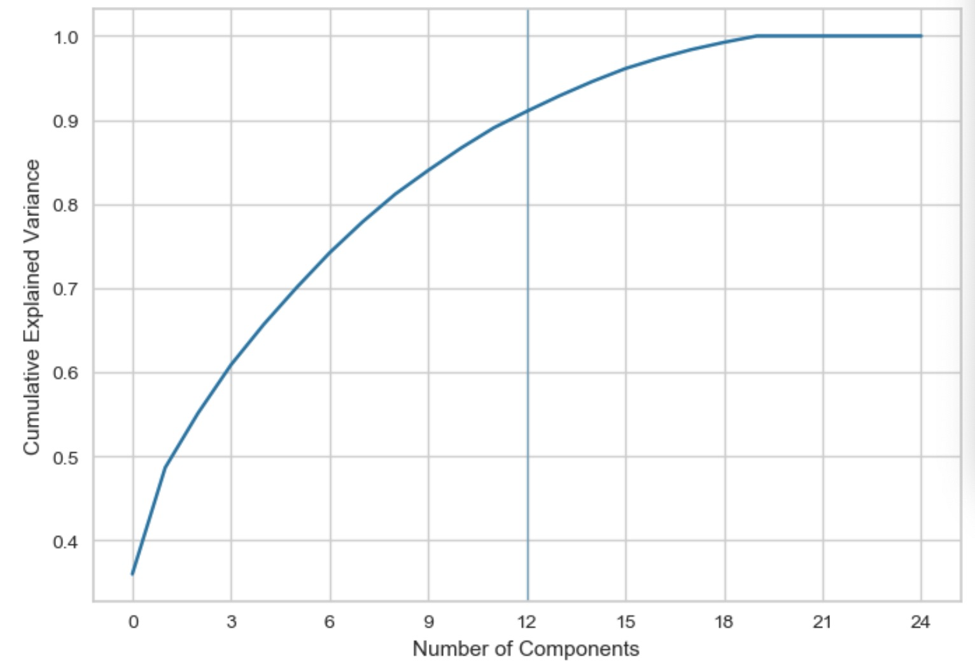
Dimensionality reduction (PCA output)
From cumulative explained variance plot, we choose 12 PC for our clustering.

Slide 11
Model Approach
K means
Agglomerative Clustering
DBSCAN

Slide 12
Model Development - K Means
Two assumptions regarding the clusters:
Clusters are spherical: Spherical assumption helps in separating the clusters when the algorithm works on the data and forms clusters.
Clusters are of similar size: If the clusters have widely different sizes, K-Means may assign more points to the larger clusters and fewer points to the smaller ones, resulting in inaccurate clustering.
Our dataset may not meet these assumptions, so the results from K means do not show clear separation among clusters.

Slide 13
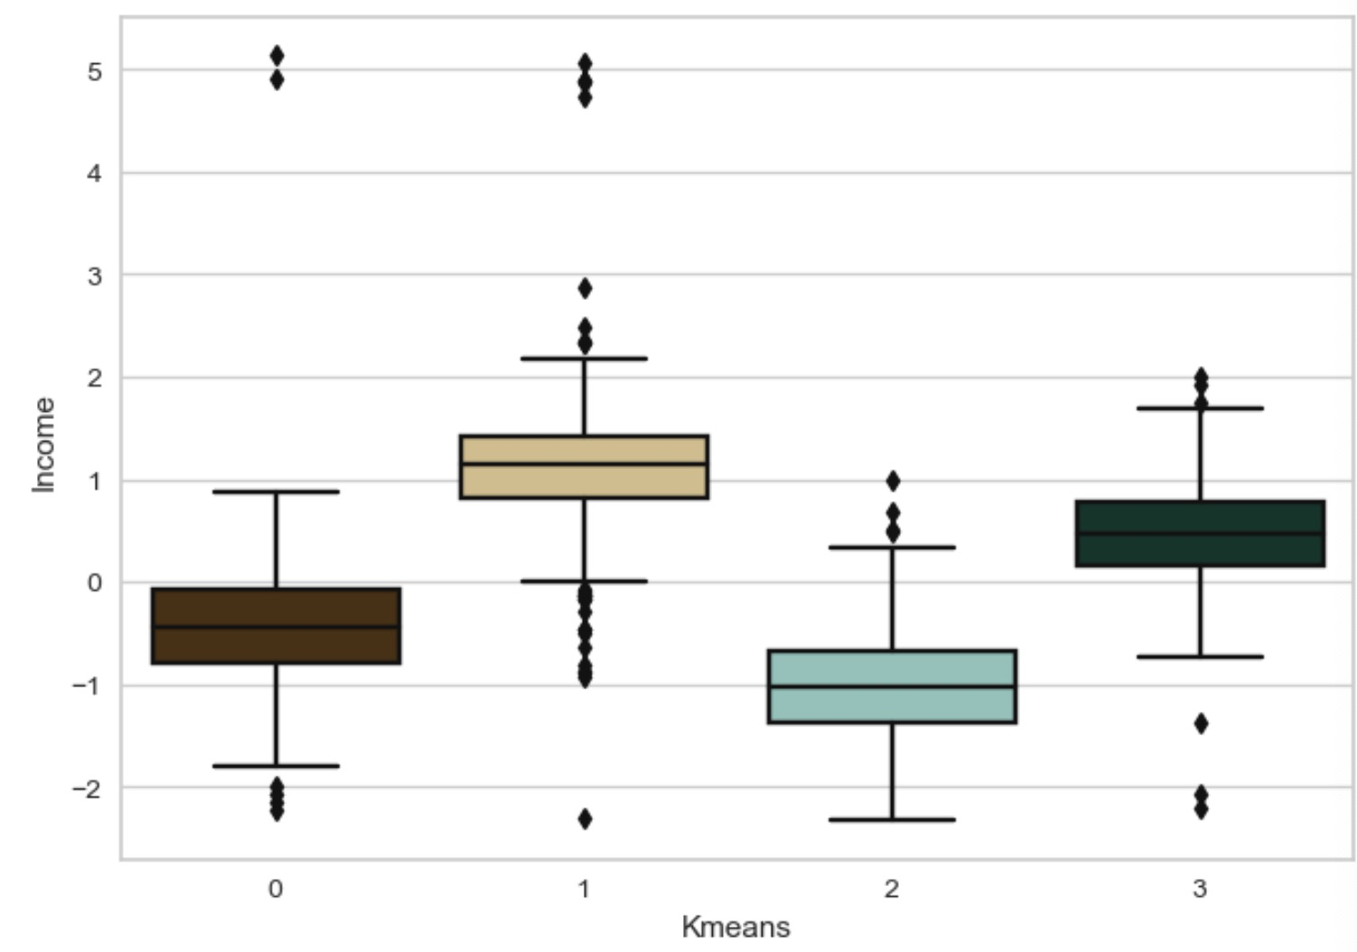
K-Means Clusters hardly distinguish Income level

Slide 14
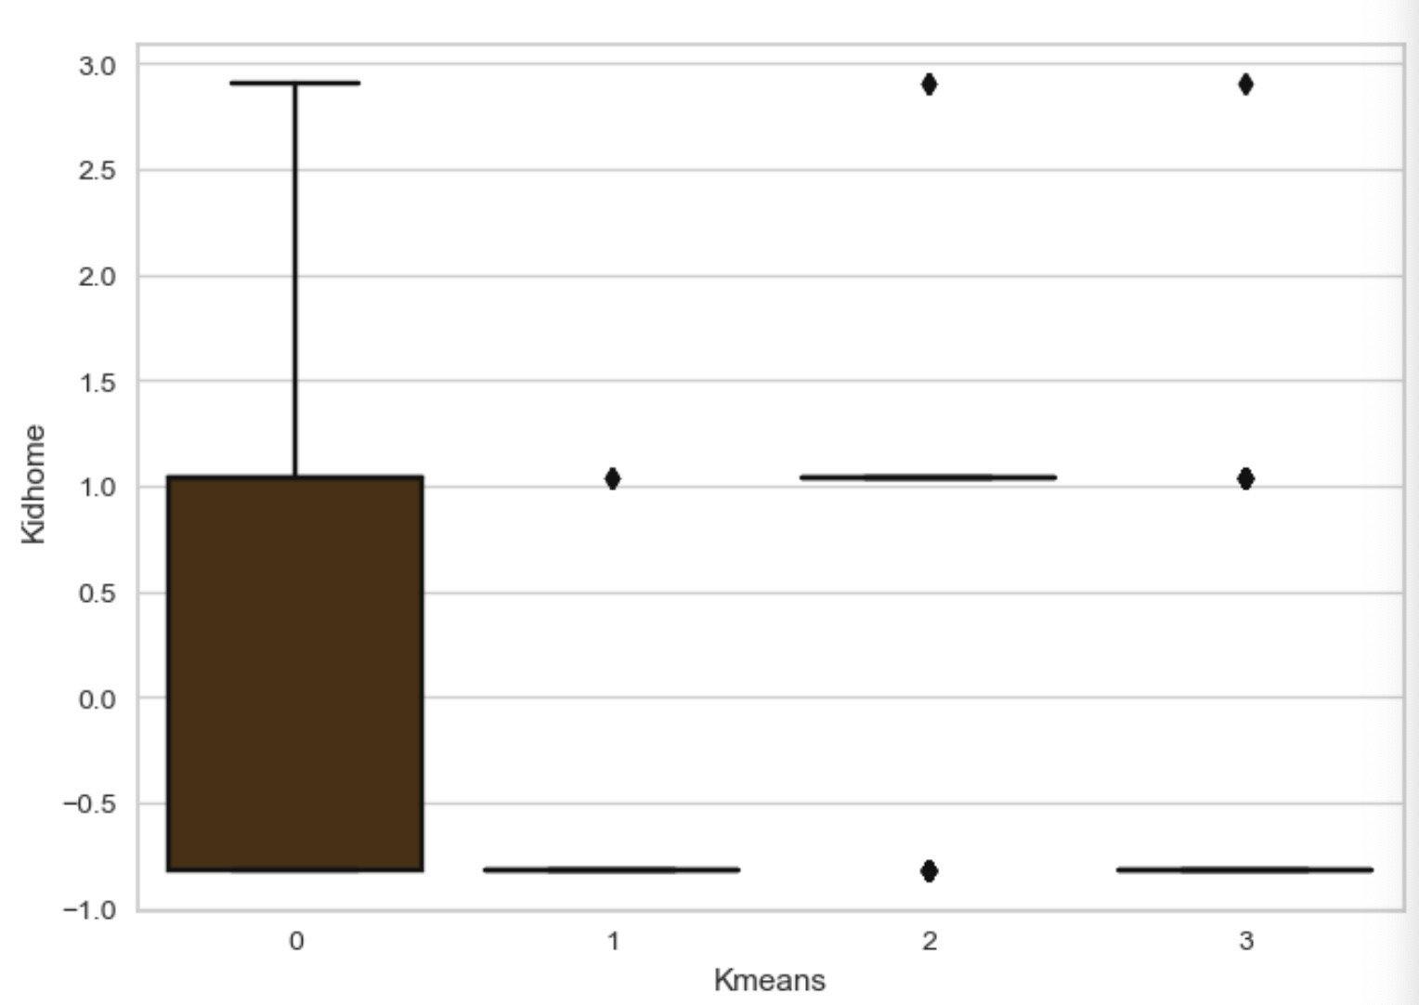
K-Means could not cluster kids per home

Slide 15
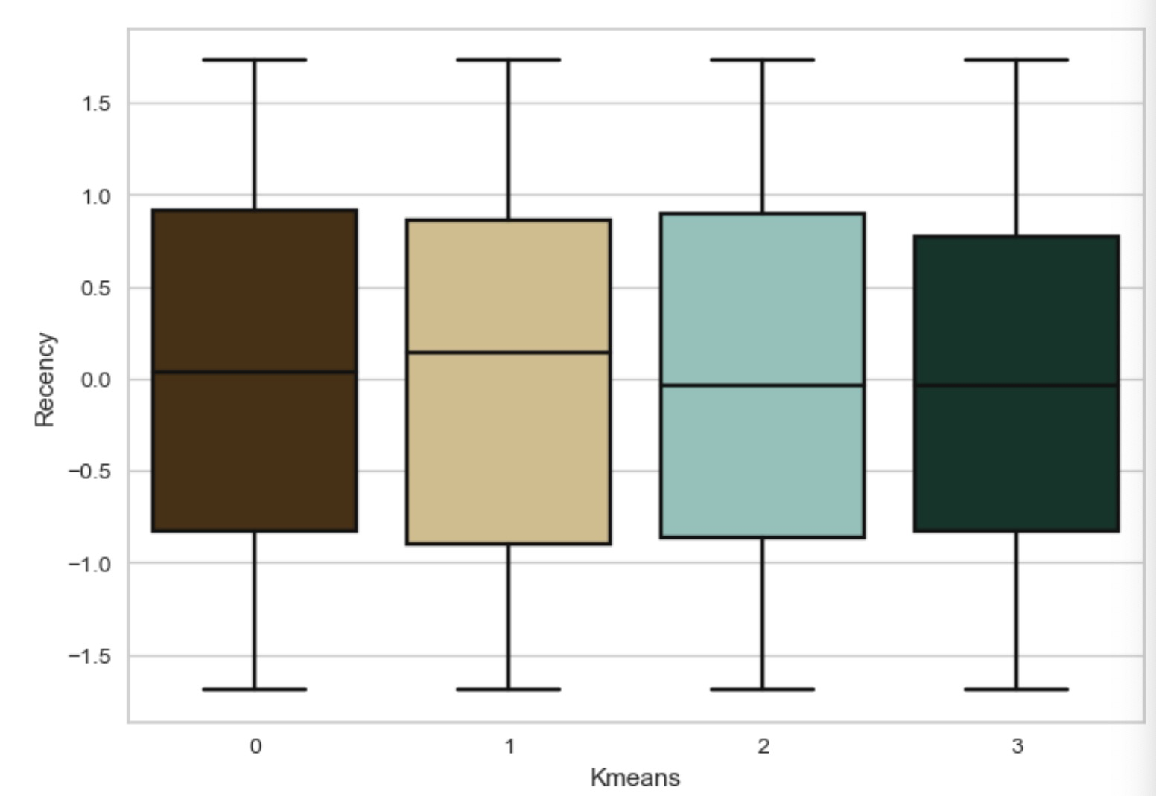
K-Means could not differentiate Recency

Slide 16
Model Development - DBSCAN
Struggles with high dimensional data
Depends on a single epsilon value for all clusters, so clusters with variable densities may not be correctly identified
Extremely sensitive to input parameters: the minimum number of points required to form a dense region (MinPts) and a distance measure (Eps)
Points reachable from two clusters may be arbitrarily classified
Since our data are closely distributed and the number of principal components=12, it is not suitable to use density-based clustering methods such as DBSCAN for this project.

Slide 17
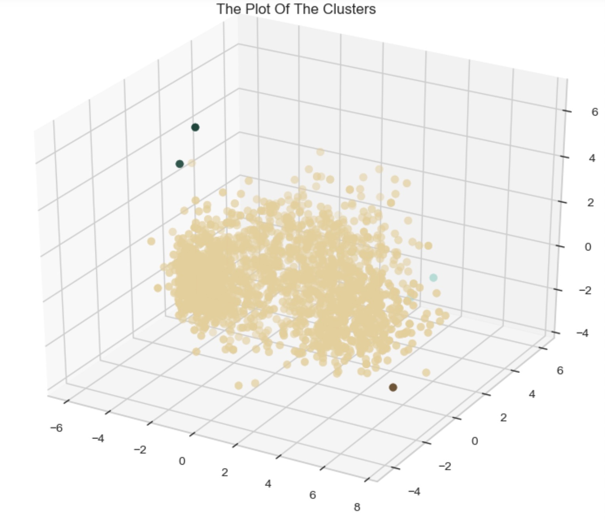
DBSCAN could only distinguish outliers

Slide 18
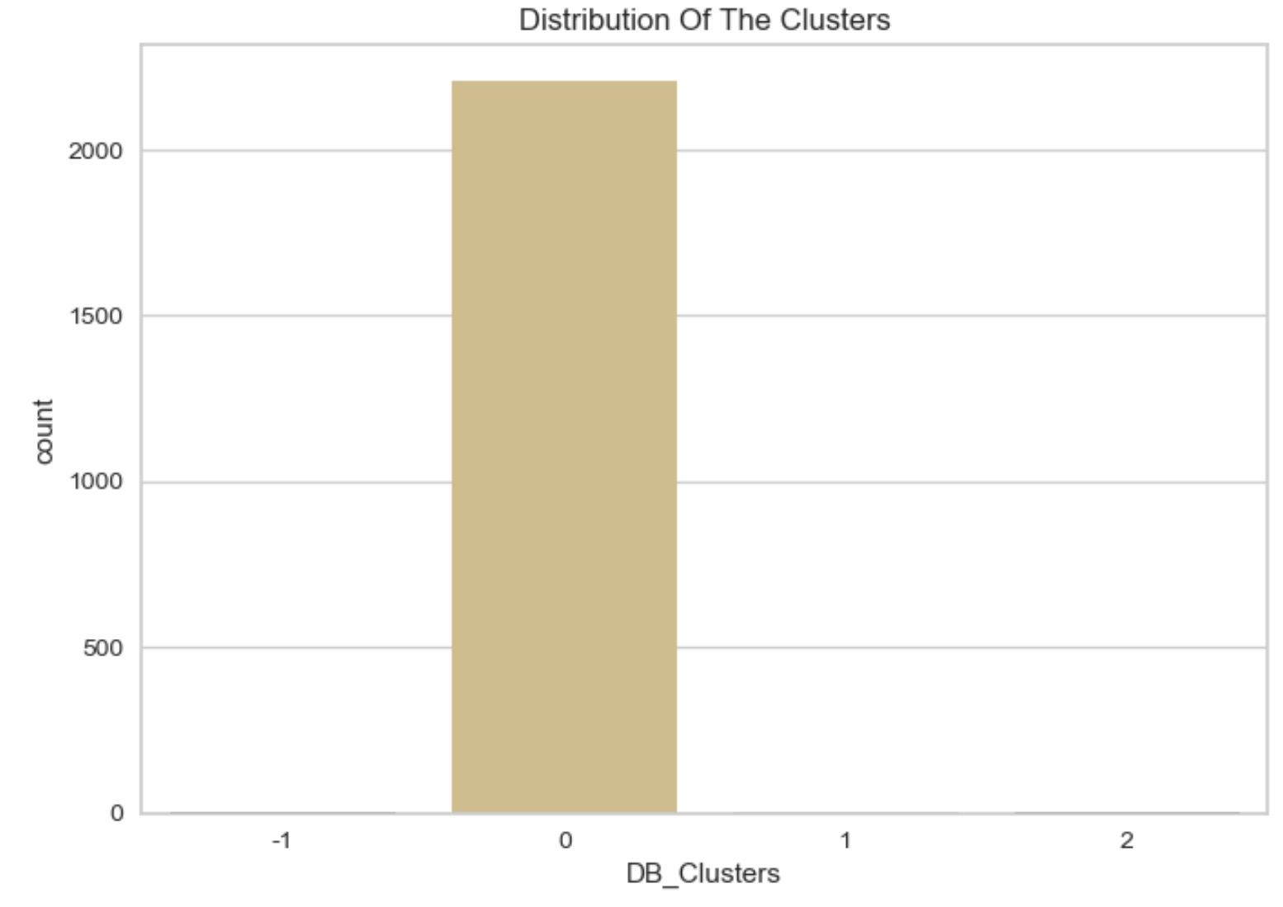
DBSCAN give imbalanced clusters

Slide 19
Model Development – Agglomerative Clustering
Hierarchical structure: A hierarchical structure of clusters is useful for understanding the relationships between data points, identifying meaningful patterns in the data, and visualizing the clustering results as opposed to flat clustering methods.
No need to specify the number of clusters: This can be an advantage in situations where the number of clusters is unknown or varies depending on the data.
Robustness: Agglomerative clustering is robust to noise and outliers in the data, as these points will be clustered with other nearby points based on their similarity.
Unlike DBSCAN and K-Means, Agglomerative Clustering could successfully give us interpretable customer segmentation.

Slide 20
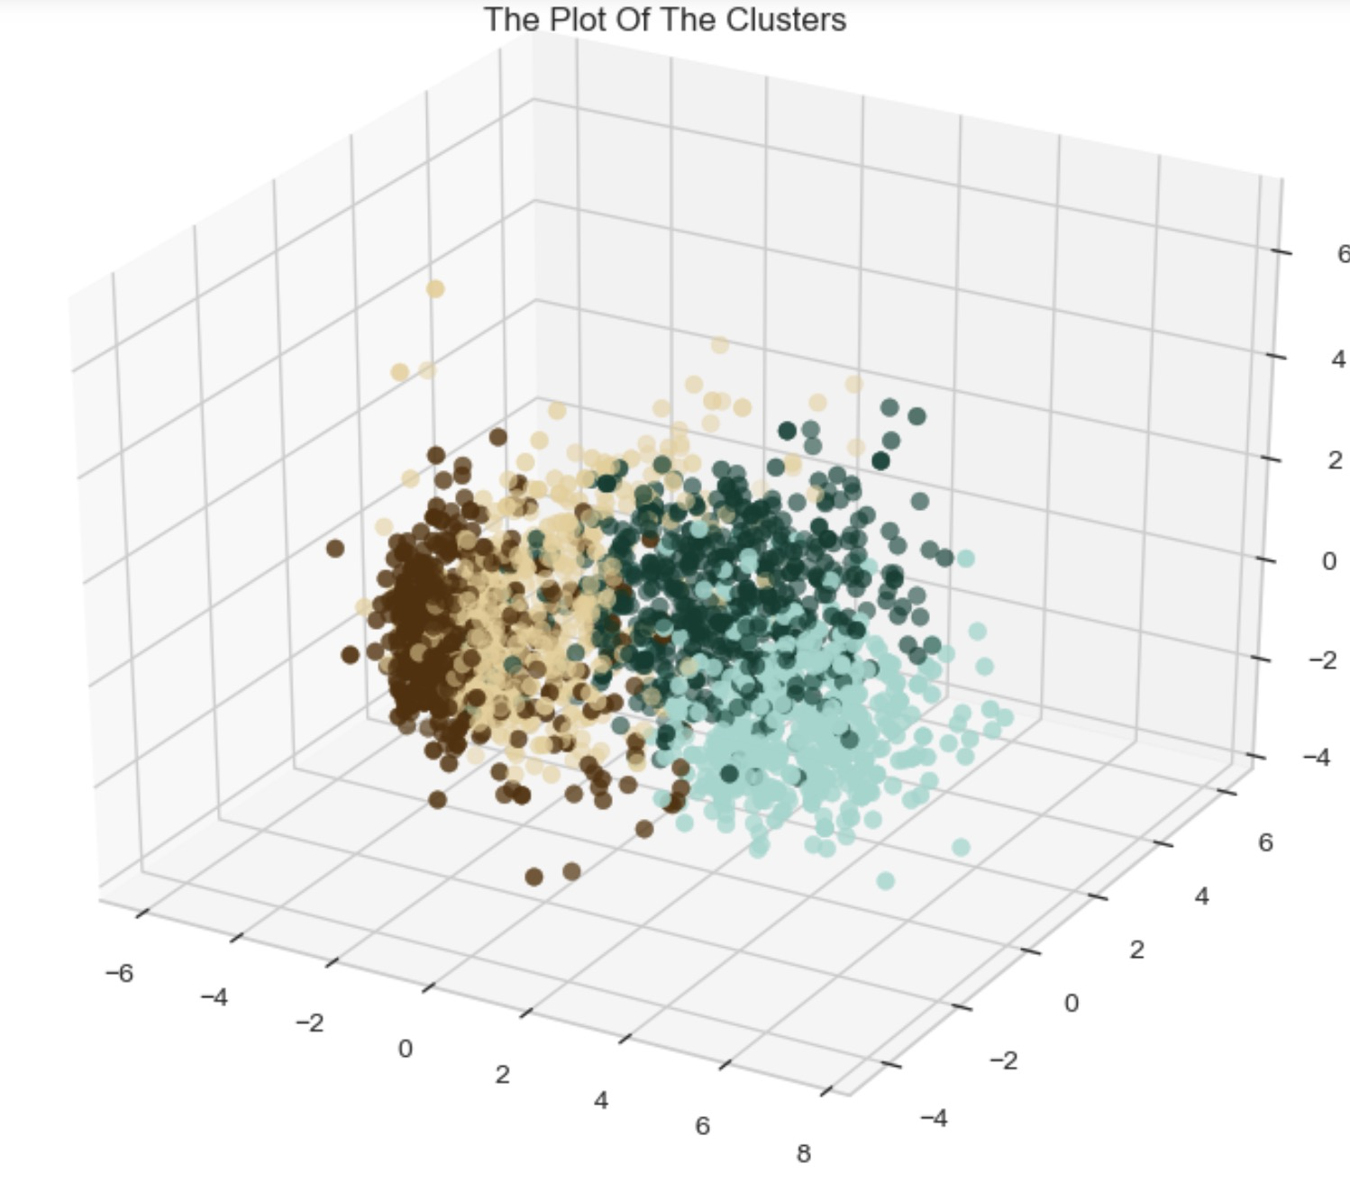
Agglomerative Clusters separate clearly

Slide 21
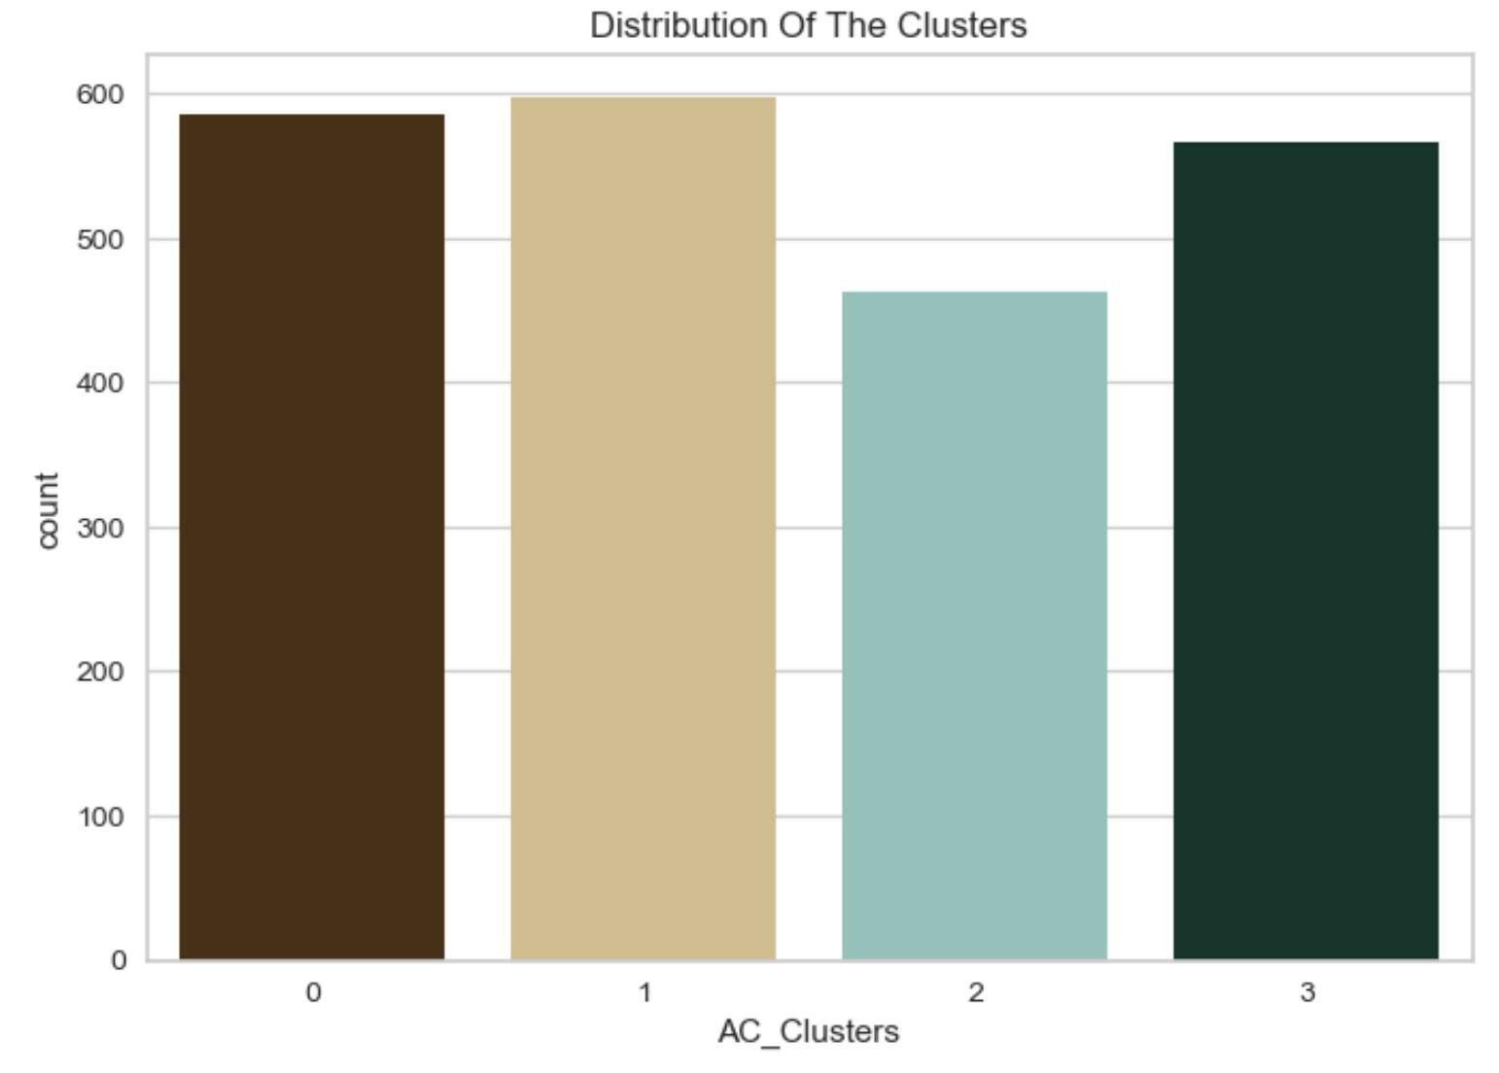
Agglomerative gives Equal-sized Clusters

Slide 22
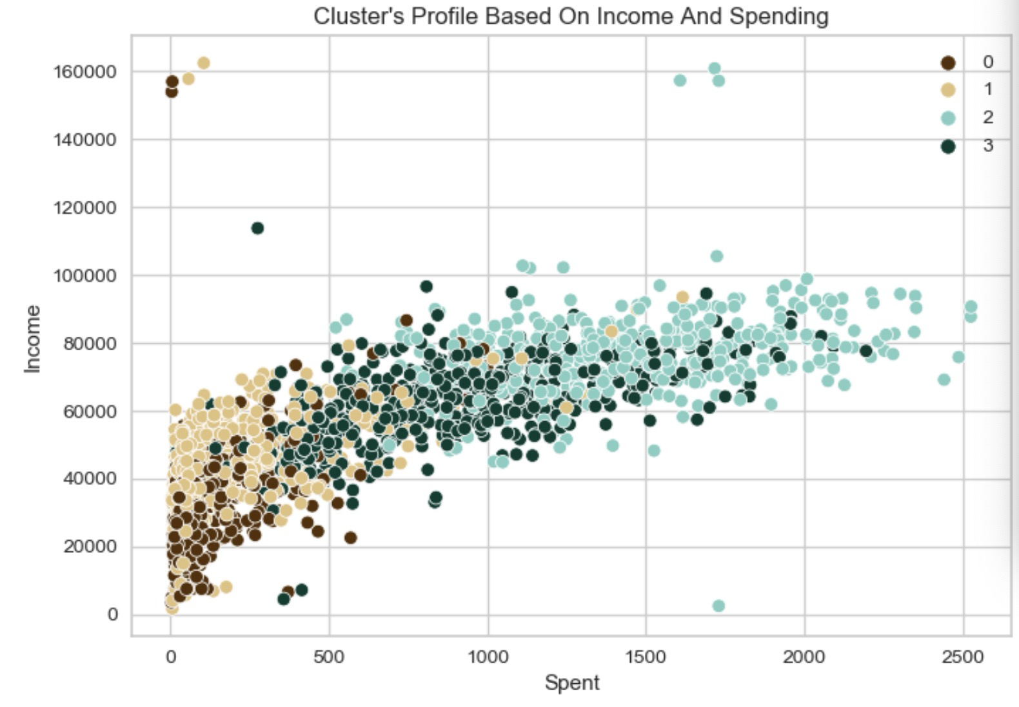
Findings
Cluster profile based on income and spending:
group 0: Low income and low spending group
group 1: Average income and low spending group
group 2: High income and high spending group
group 3: High income and average spending group

Slide 23
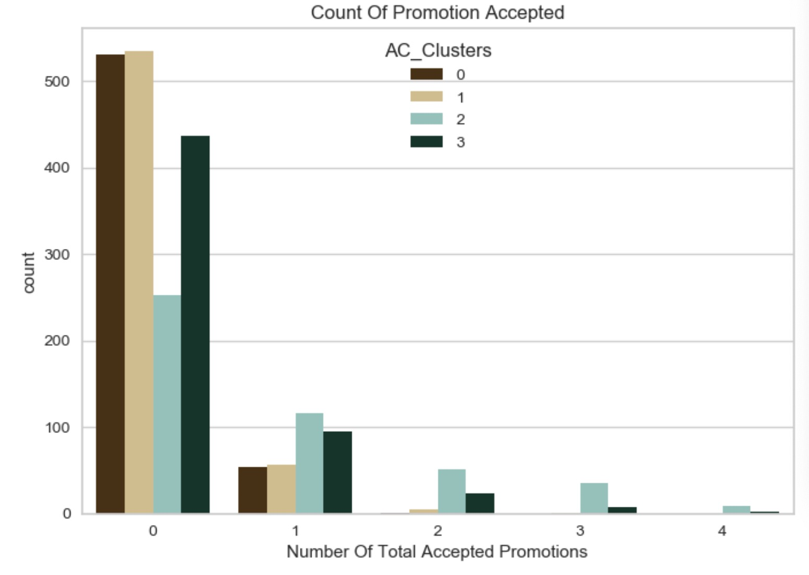
Findings
The majority of participants do not accept the promotions campaigns.
We find that group 2 and group 3 accepts our promotions more.
group 2: High income and high spending group.
group 3: High income and average spending group.

Slide 24
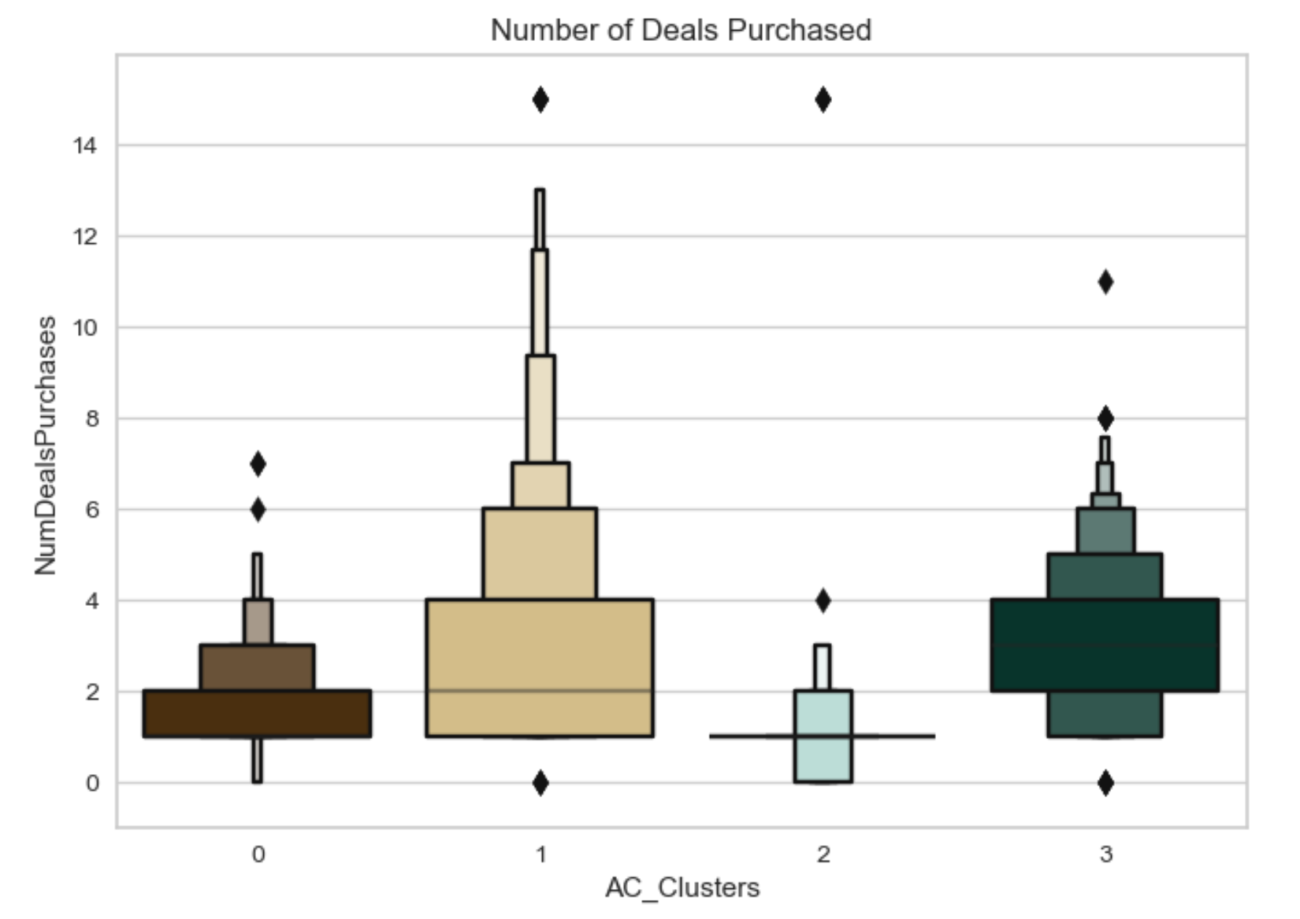
FINDINGS
For the deals, they appeal most to group 1(Average income and low spending group) and 3.
However, our best customers cluster 2 are not attracted by deals.

Slide 25
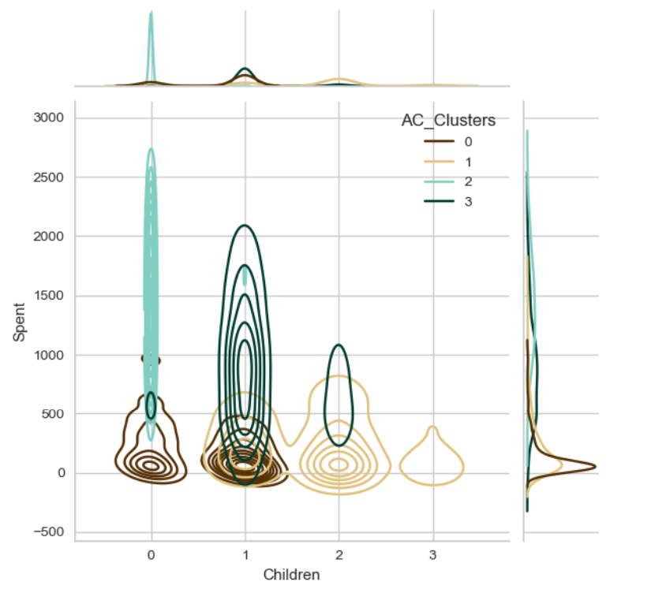
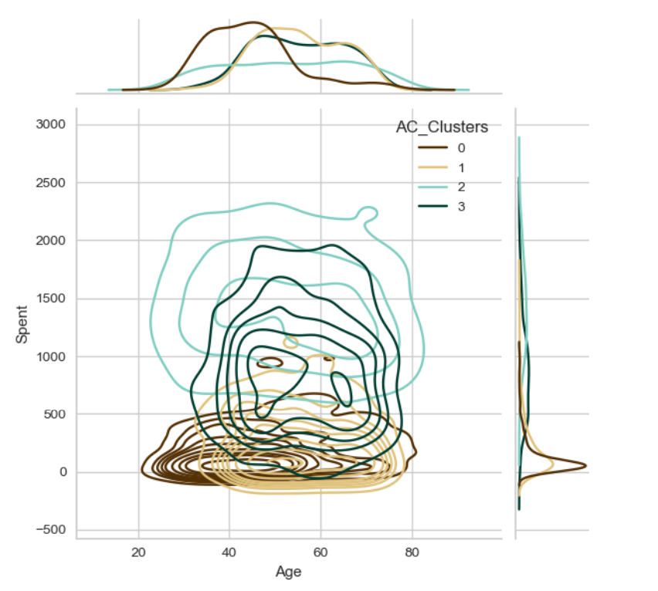
Cluster analysis

Slide 26
Cluster Characteristic
Group 0:
The majority of group 0 is relatively young and below 50 years old
0 or 1 child
Group 1:
The customers in this group are relatively older
have children
Group 2:
This group spans all ages
no children
Group 3:
The customers in this group are relatively older
1 or 2 children

Slide 27
Marketing Strategies to different groups
Group 0:
Characteristics: mostly young and have either no or only one child, they may be more price-sensitive and interested in finding deals and discounts.
Actions: To attract and retain these customers, businesses could offer competitive pricing, special promotions, and loyalty programs that reward repeat purchases. They may also be more tech-savvy and responsive to digital marketing and social media campaigns.
Group 2:
Characteristics: spans all ages and has no children, they may have more disposable income and be interested in premium products and services.
Actions: Businesses could focus on providing high-quality, luxury experiences and products, and investing in high-end marketing and branding to appeal to this group. Additionally, they may be more likely to shop online and respond to targeted digital advertising campaigns.

Slide 28
Marketing Strategies to different groups
Group 1 + 3 :
Characteristics: relatively older and have children, they may be more focused on balancing work and family responsibilities.
Actions: They may respond well to marketing campaigns that emphasize convenience, reliability, and ease of use. Businesses could offer products and services that help them save time and simplify their daily routines, such as meal delivery services, household cleaning services, and online grocery shopping.
Business should offer personalized recommendations based on their specific needs and interests, such as childcare products.
Additionally, they may prefer email marketing as channels to receive promotions and discounts, or traditional advertising channels such as TV and print media..

Slide 29
Q&A

Slide 30
Paper Review
link

